Slide 1
Camera trapping
to study animal behaviour

Slide 2
Camera traps:
History and use

Slide 3
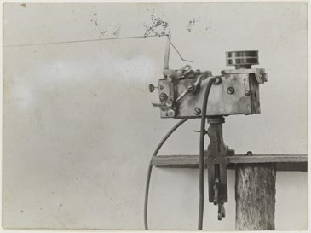
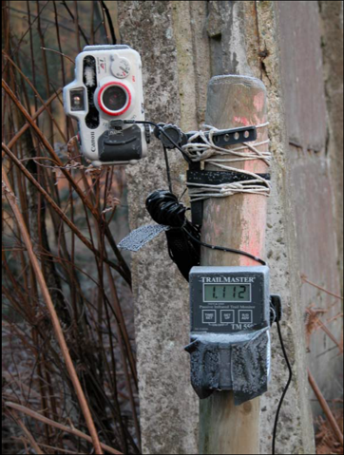
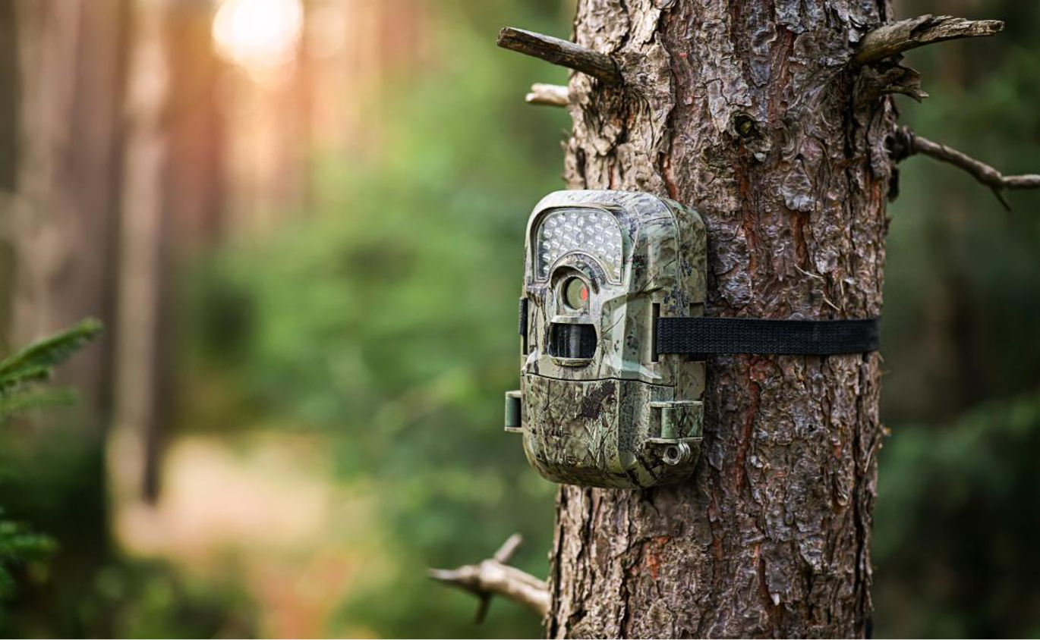
1890s
First automatic
detection system
First use of CTs by hunters
2020s
Modern CTs with built-in automatic detection system

Slide 4
Why should we use Camera traps (CTs)?
Pro’s:
Non-invasive
Less labour intensive
Continuous monitoring
Multi-species
Easily standardized
Well documented observations
Cons:
Mostly limited to mid-sized mammals
Data management
No information on fine-scale movement patterns
Limited detectability
Unable to identify individuals without markings

Slide 5
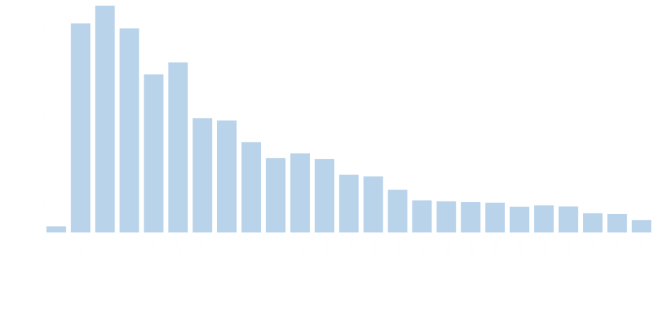
Increasing use of CTs
710
700
35
1995
2018
Number of records in Web of Science after searching “camera-trap”.
Notes:
Genetic (species, varieties, etc.)
Life form (grasses, forb, trees, mosses, etc.)
Functional group (deep rooted, nitrogen-fixing, soil crust, evergreen, etc
Organismale diversiteit (morphologie, anatomie,..); populatie diversiteit (densiteiten, freqeunties…), biogeografische diversiteit (diversiteit in geologie, geografische geschiedenis)…

Slide 6
What have CTs been used for?
Initially, focus on:
Nesting behaviour of birds
Nest predation
Currently, focus on:
Animal behaviour
Absence/ presence
Popultion parameters: abundance, density

Slide 7
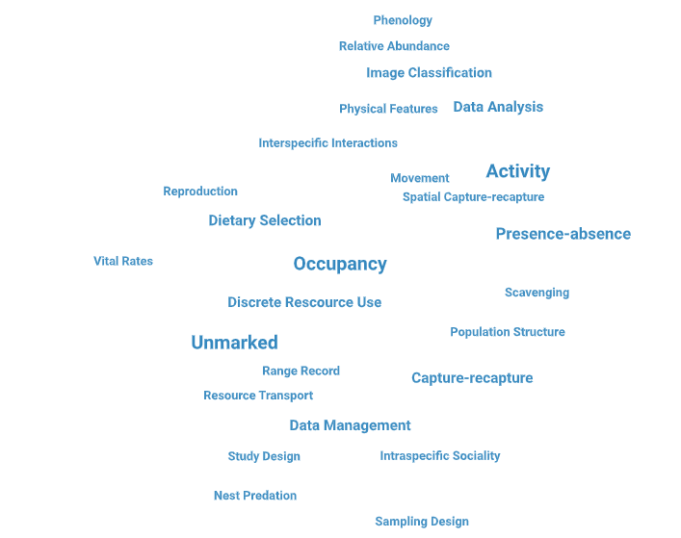
CT topics
Delisle et al. 2019

Slide 8
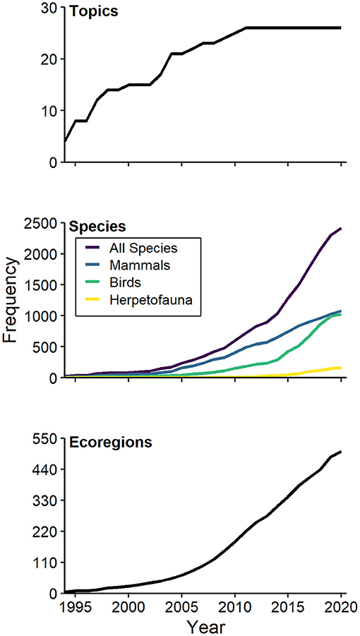
CTs a technique that has matured
Diversity in topics reached a “plateau” around 2010
Increasing No. of species being recorded
Mammals remain the dominant focal group
Increasing No. Of ecoregions being surveyed
Delisle et al. 2019

Slide 9
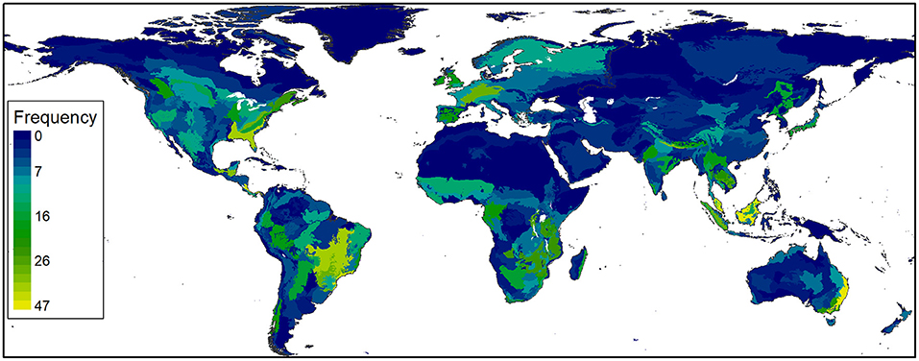
CT networks around the globe
Delisle et al. 2019

Slide 10
Camera trap data:
How to collect standardized species records

Slide 11
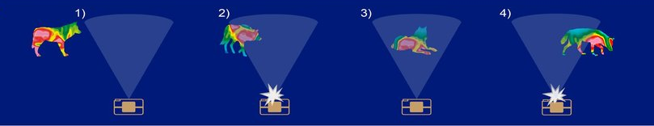
How do CTs work?
An infrared sensor measures ∆T. Moving animals with a T different from the background T trigger the CT (2, 4). Animals outside of the detection field (1) or resting (3) are not captured.
Wearn, Oliver & Glover-Kapfer, Paul. 2017

Slide 12
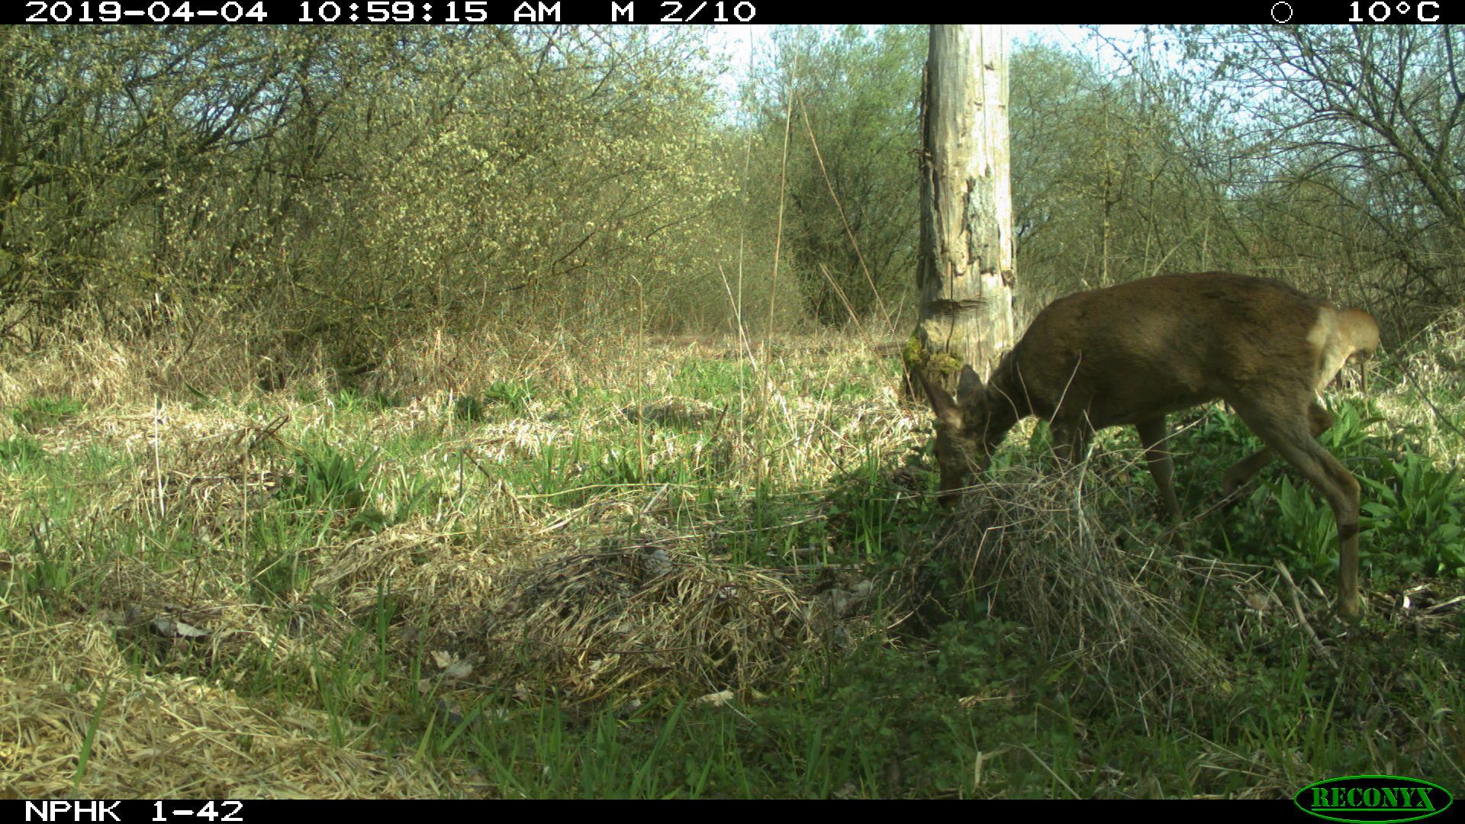
Information retrieved from CT pictures
Date & time

Slide 13
Information retrieved from CT pictures
No. pictures

Slide 14
Information retrieved from CT pictures
Temperature

Slide 15
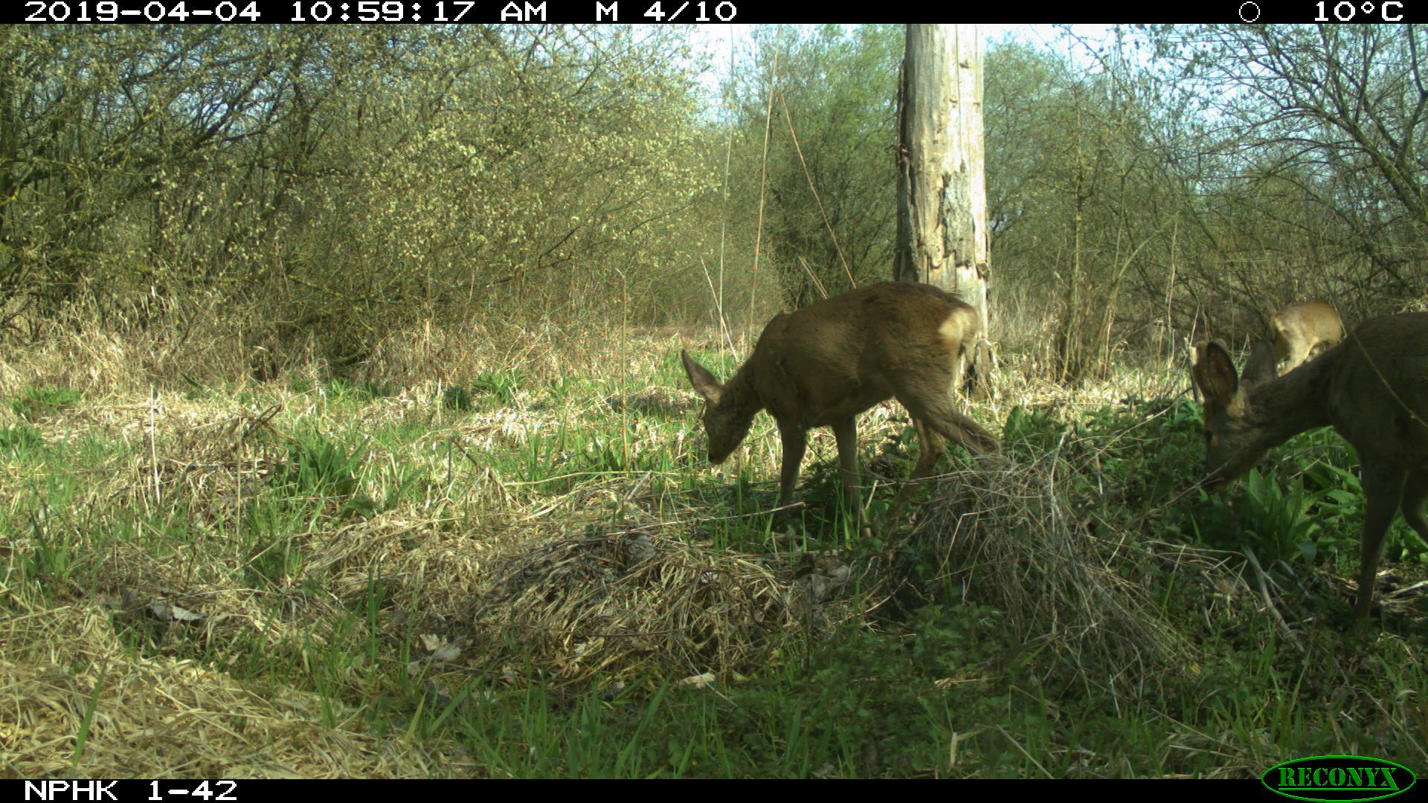
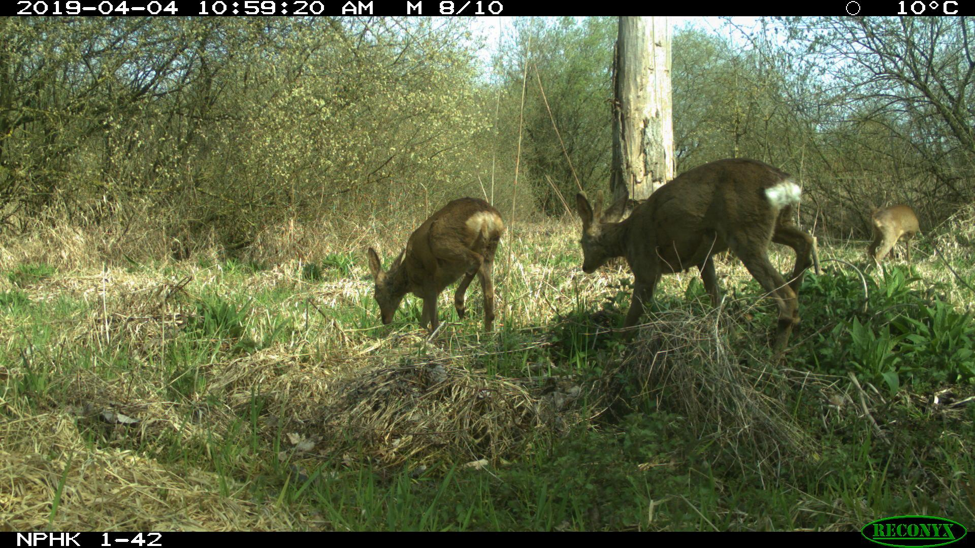
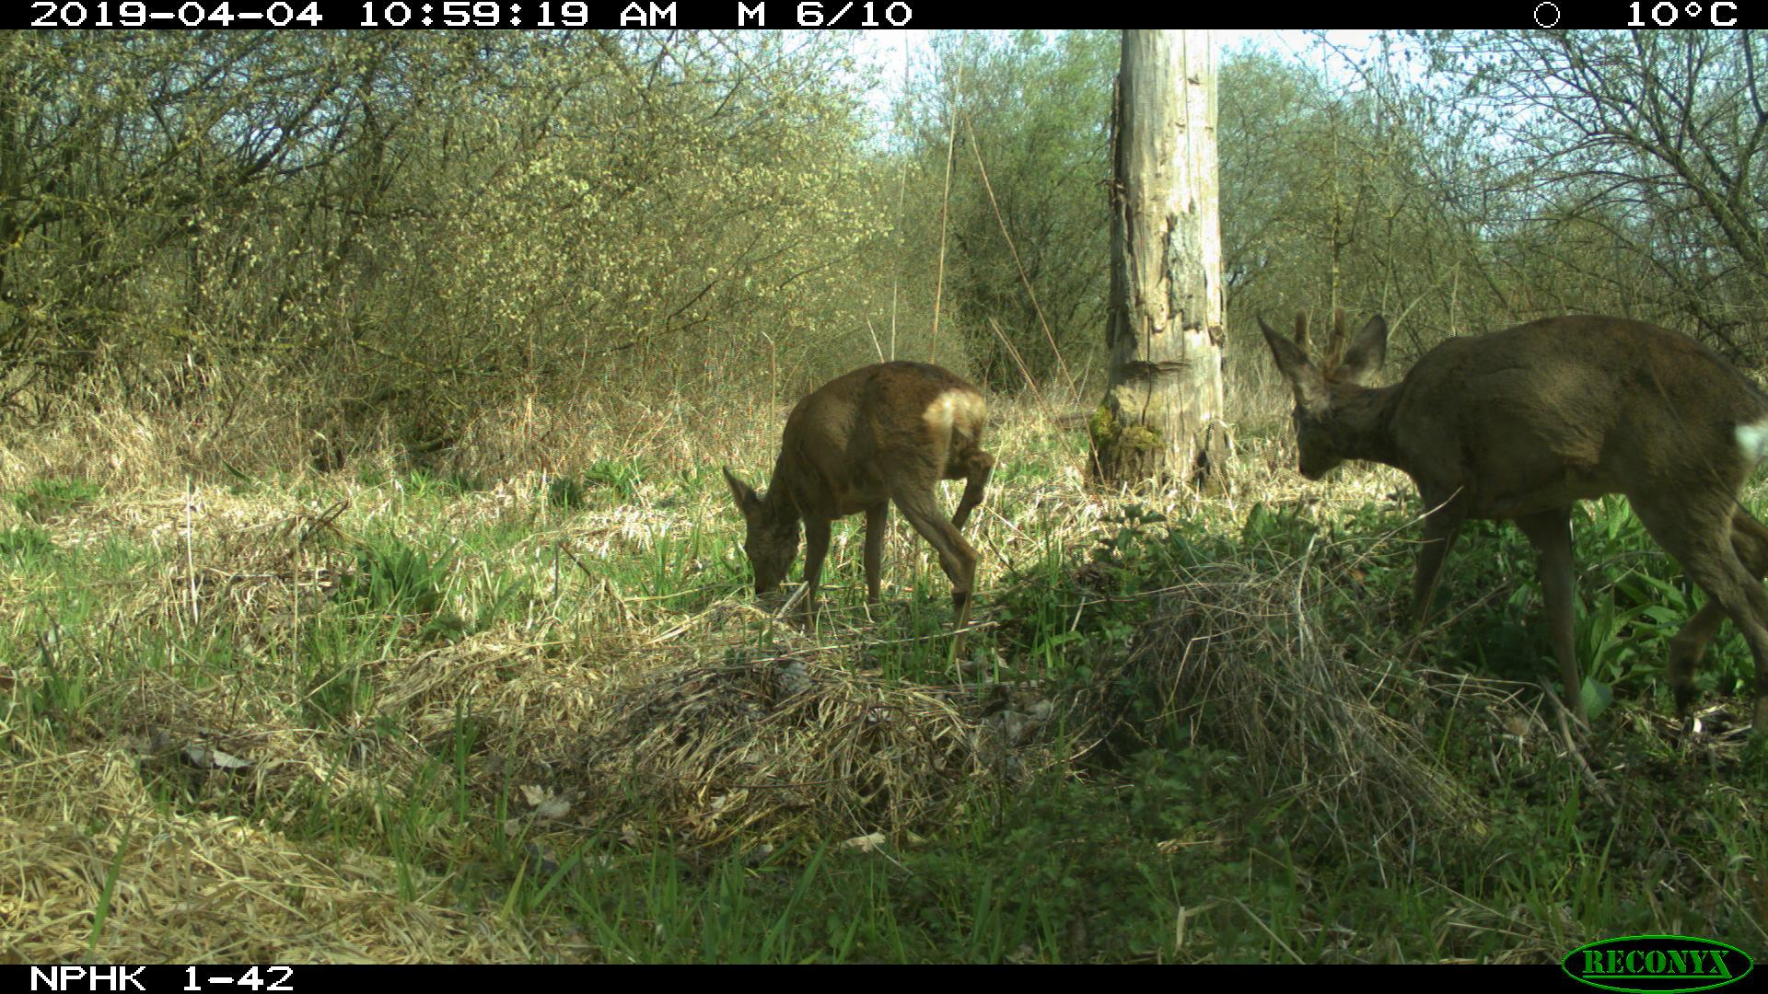
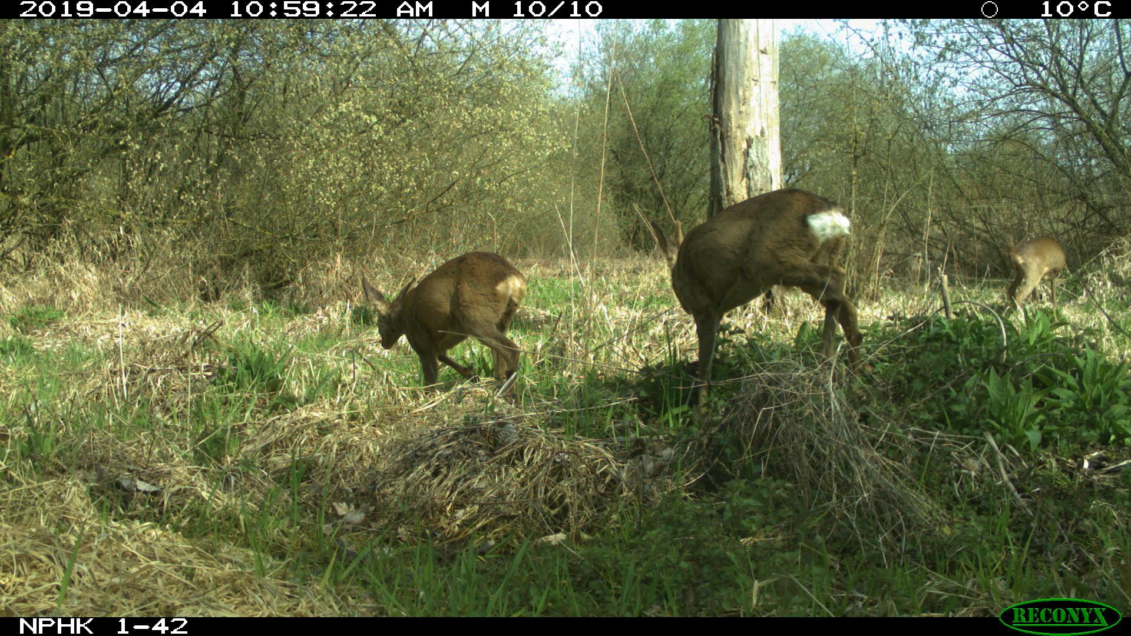
Information retrieved from CT “sequences”
Species:
roe deer
No. of individuals:
3
Optional:
age class, sex

Slide 16

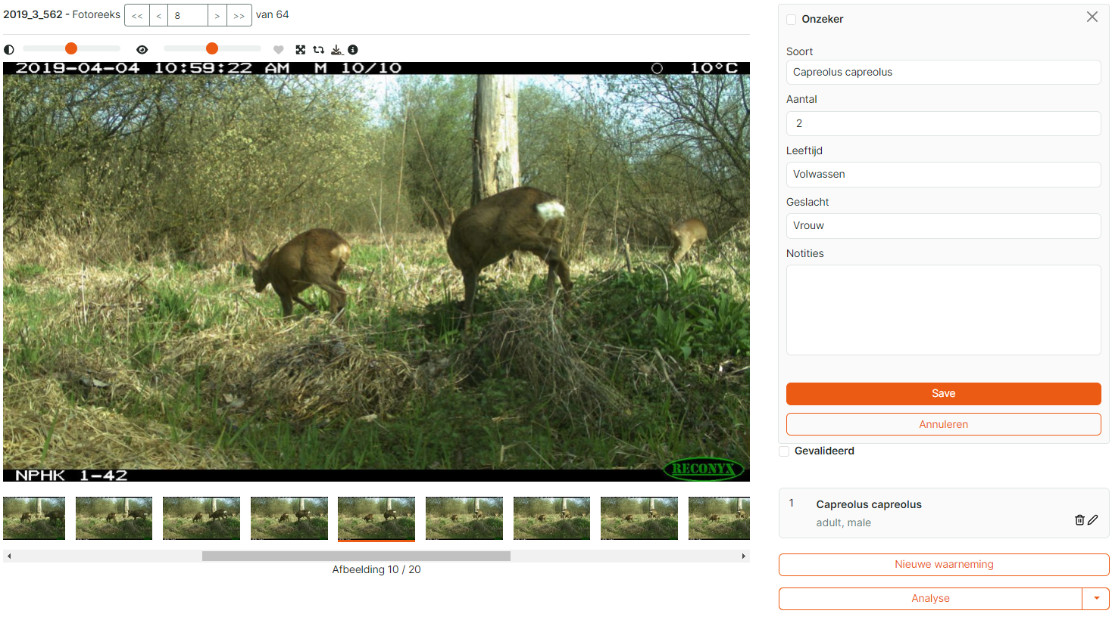
Agouti

Slide 17
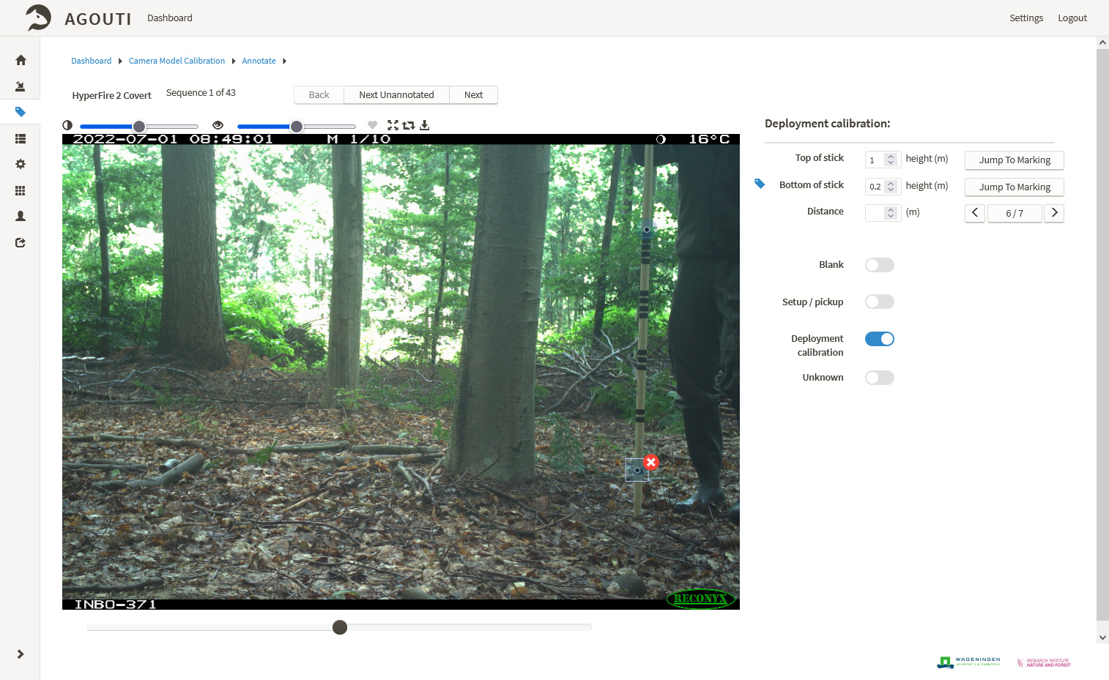
③

Slide 18
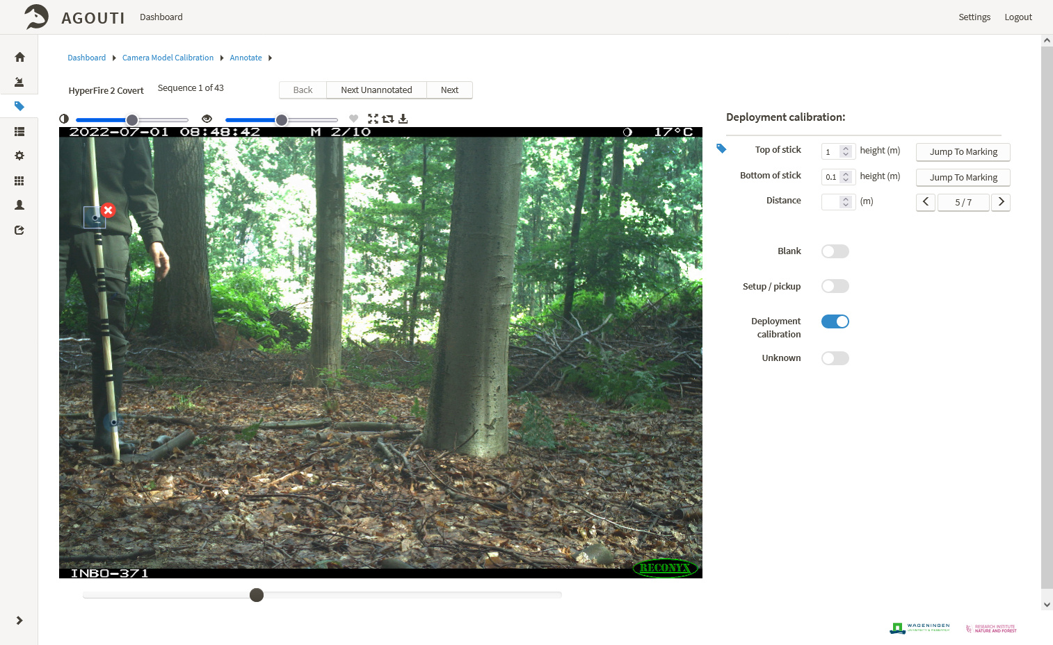

Slide 19
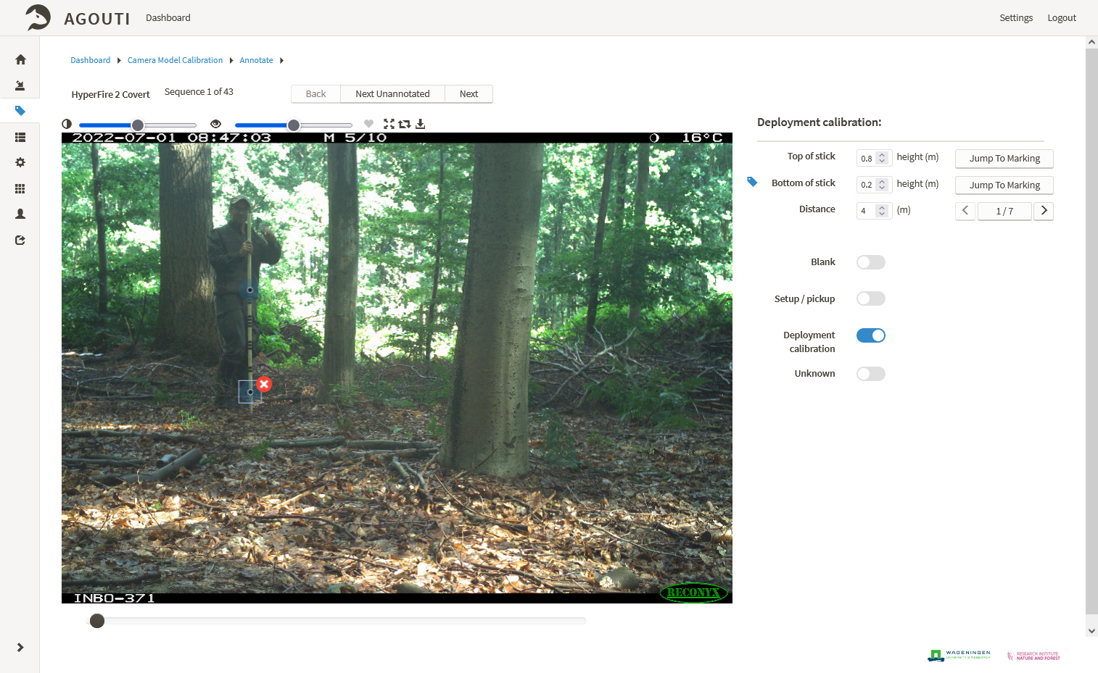

Slide 20
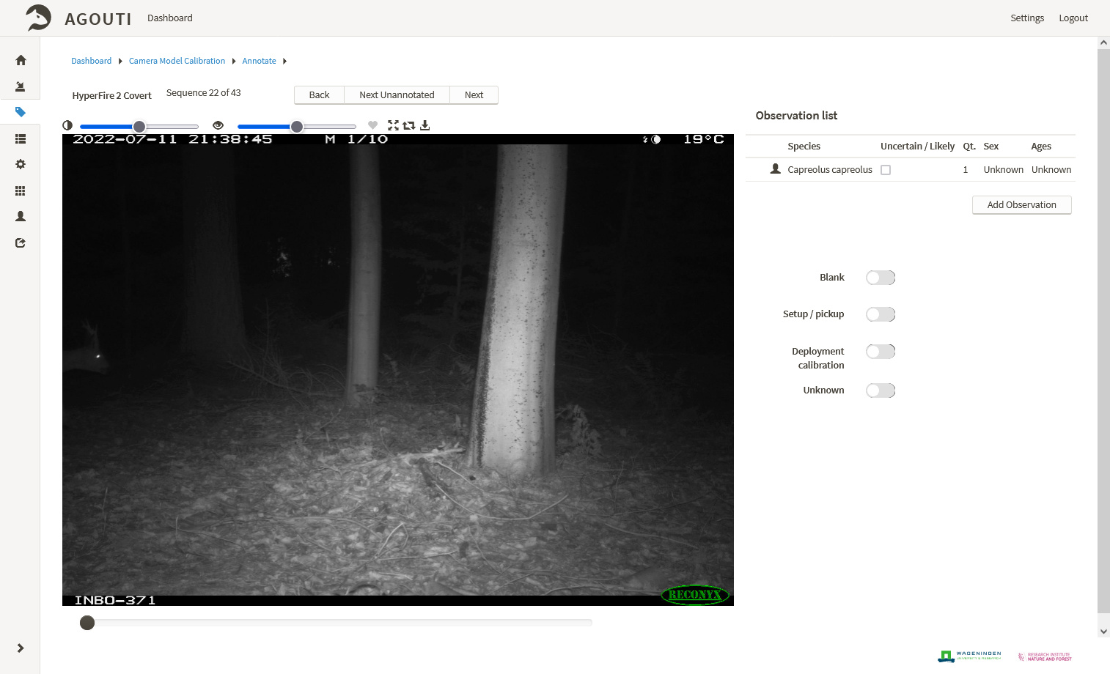

Slide 21
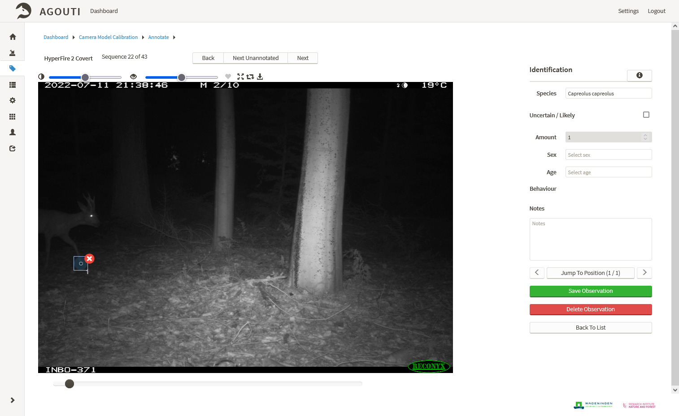

Slide 22
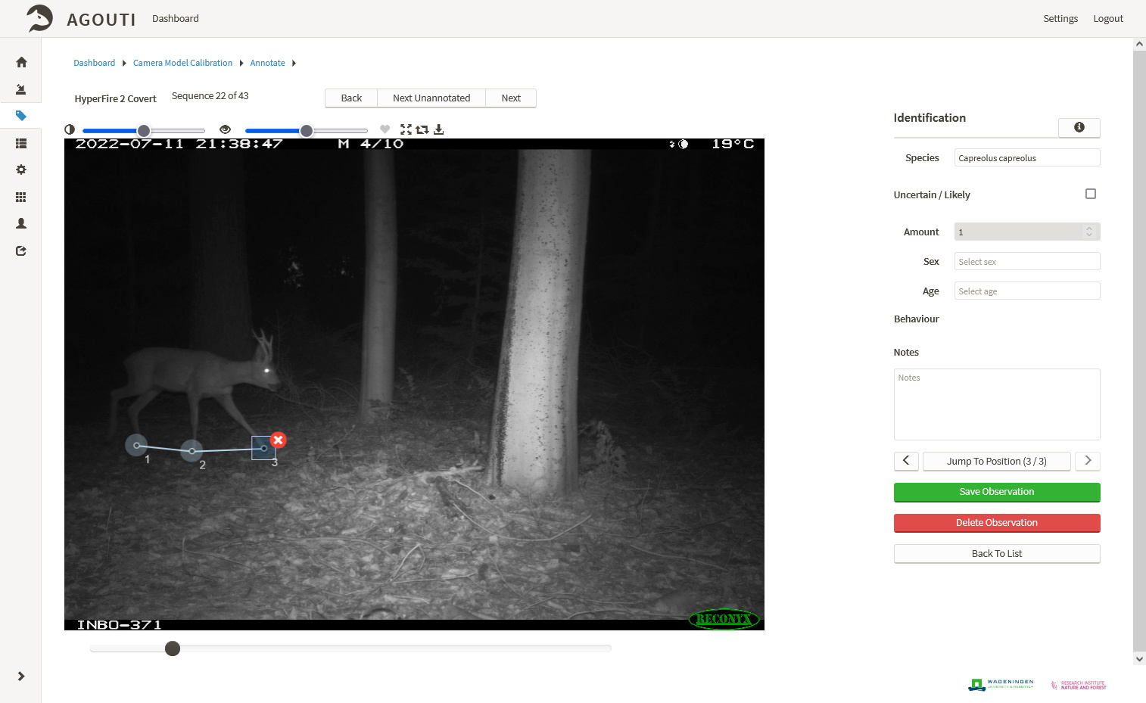

Slide 23
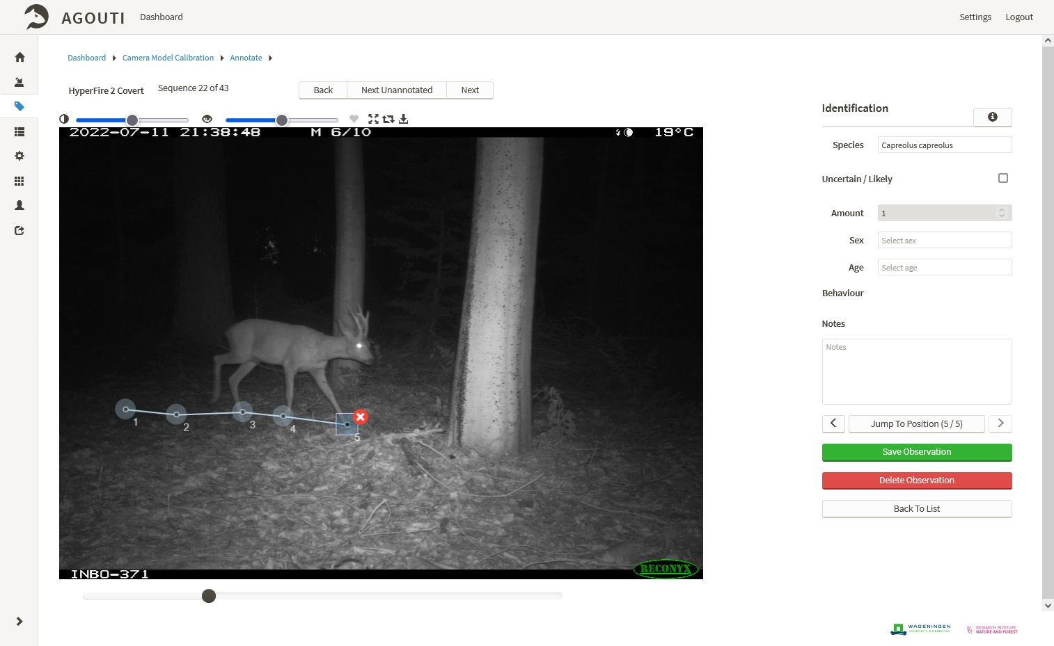

Slide 24
FAIR camera trap data
Findable, accessible, interoperable and reusable

Slide 25
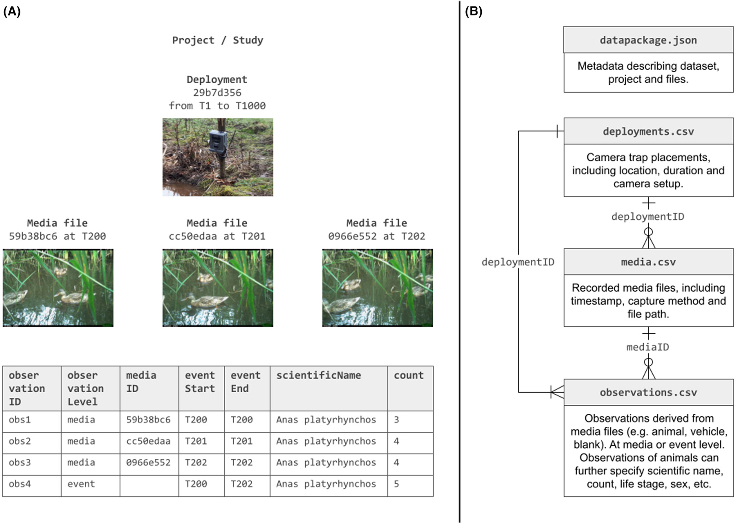

Bubnicki et al. 2024

Slide 26
Data analysis:
How to analyse camera trap data

Slide 27
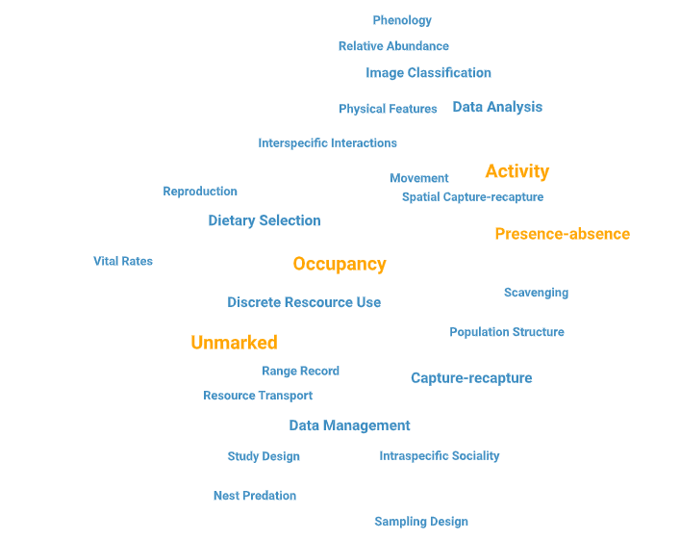
CT topics covered today
Delisle et al. 2019

Slide 28
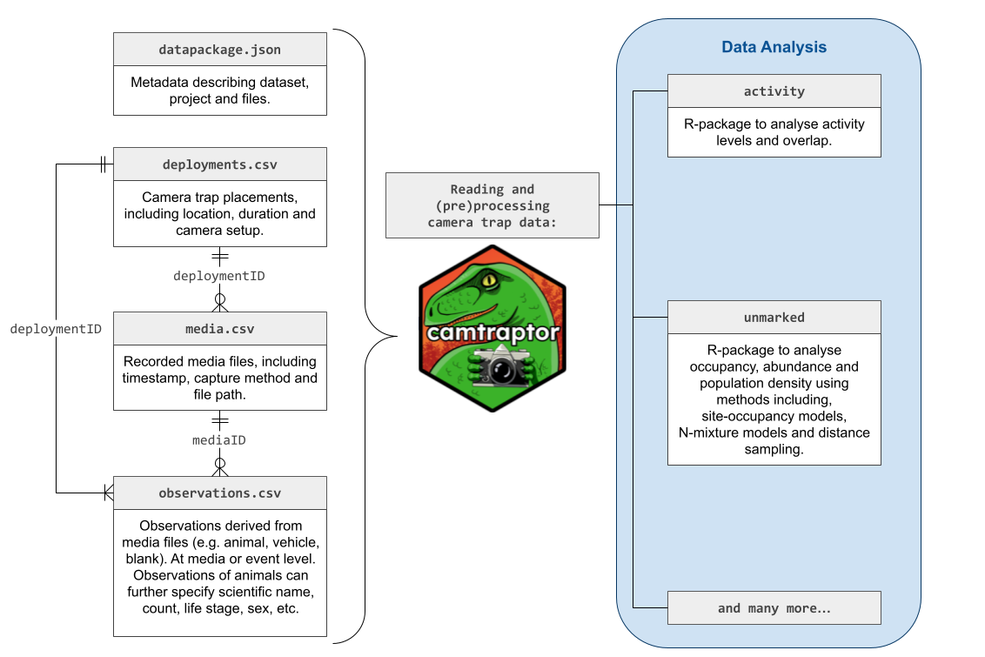

Slide 29
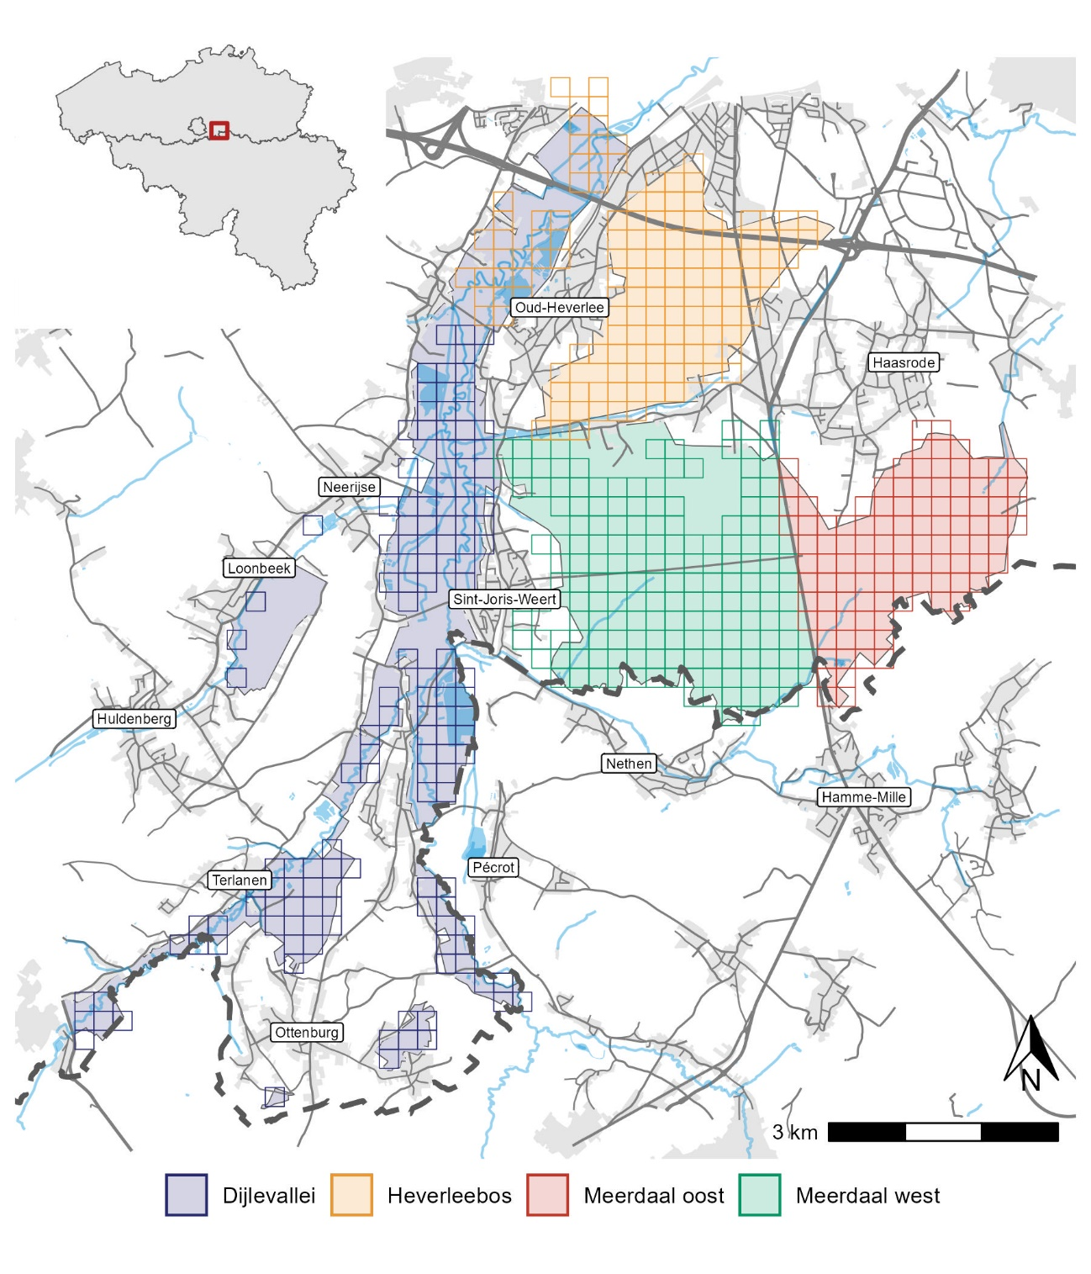
Case study:
Data from 2019 for
Wild boar
Roe deer
Red fox

Slide 30

Let’s try reading in the data

Slide 31
Activity
“daily or seasonal timing and distribution of animal movements and behaviours”
usually the daily cycle of activity (24h)
CTs allow studying activity patterns
Collection of time-referenced images
“activity” package in R

Slide 32
Activity
Convert timestamps of observations into radians (0 - 2π)
Optional: convert radian clock times → solar times
Fit a kernel density estimator to the clock/ solar times
activity::fitact

Slide 33
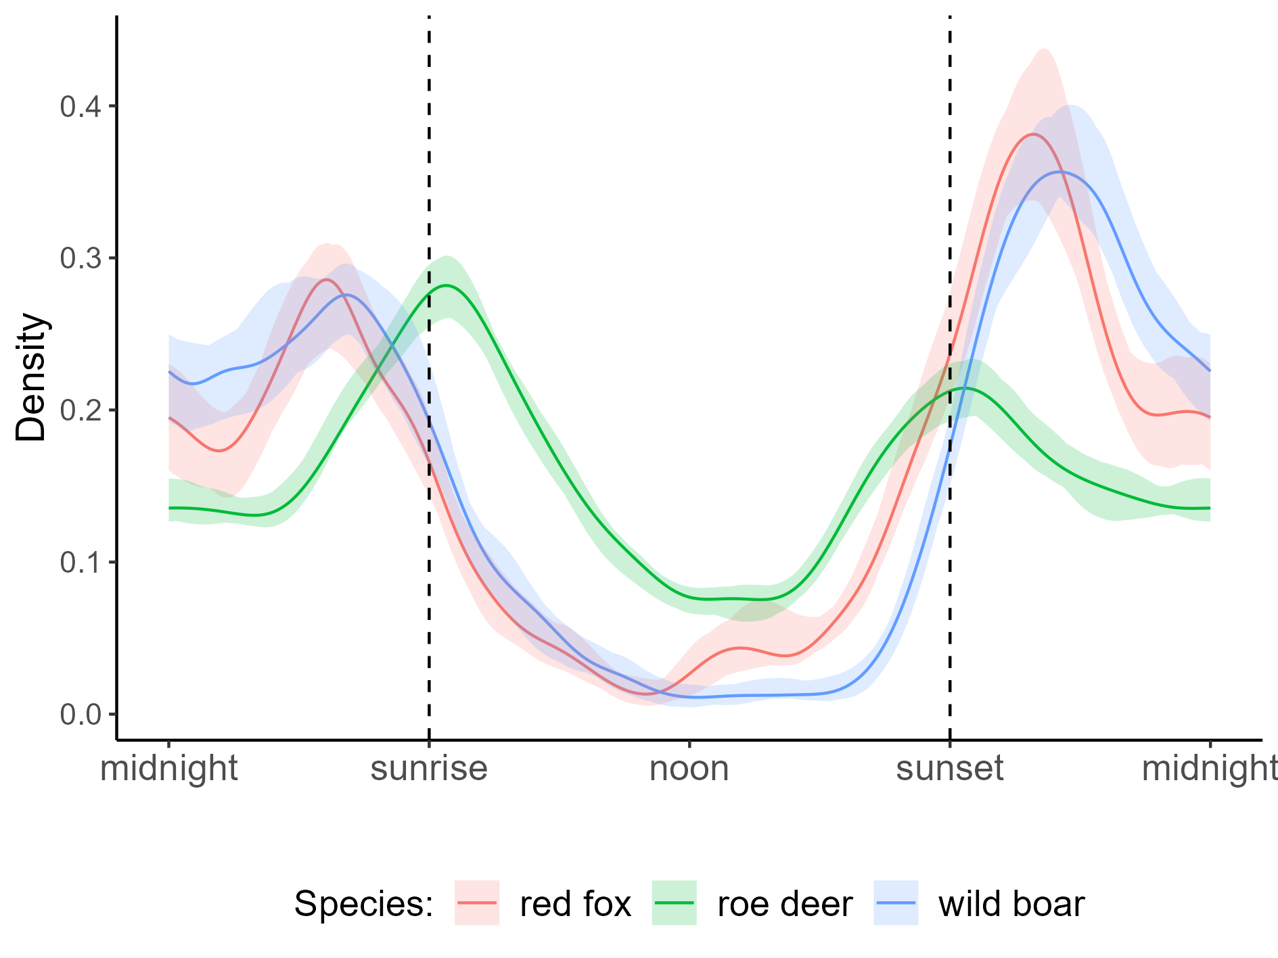
Activity

Slide 34
Let’s try fitting activity patterns

Slide 35
Absence-presence
“Is a species being recorded, at least once, at a given location?”
… but what if the species was NOT recorded
is it truly absent?

Slide 36
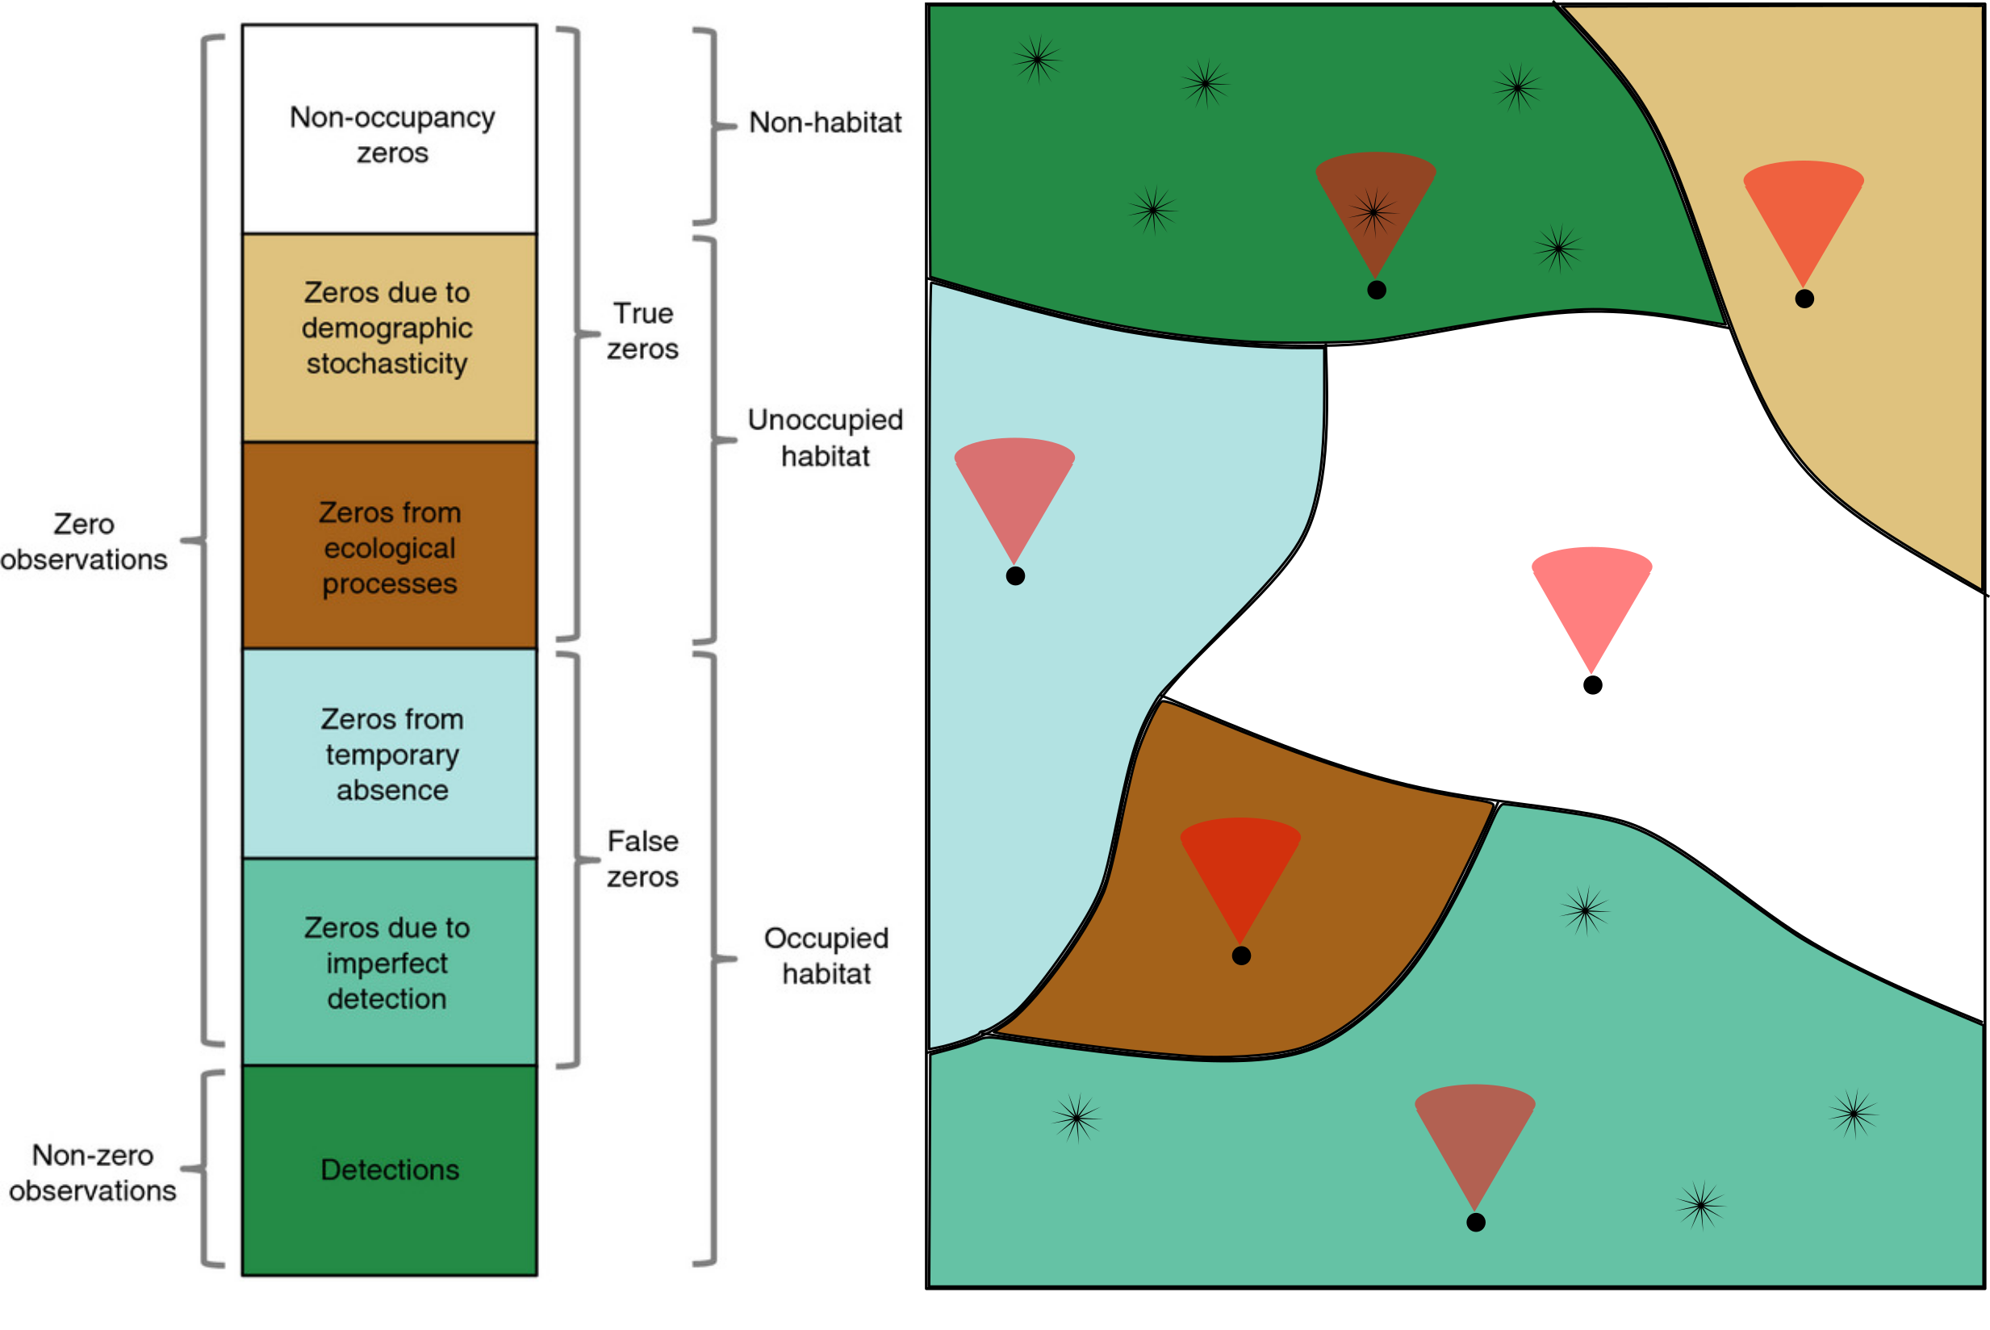


The occurence of ‘0’ in ecological surveys
Camera trap
Animal
Dénes et al. 2015

Slide 37
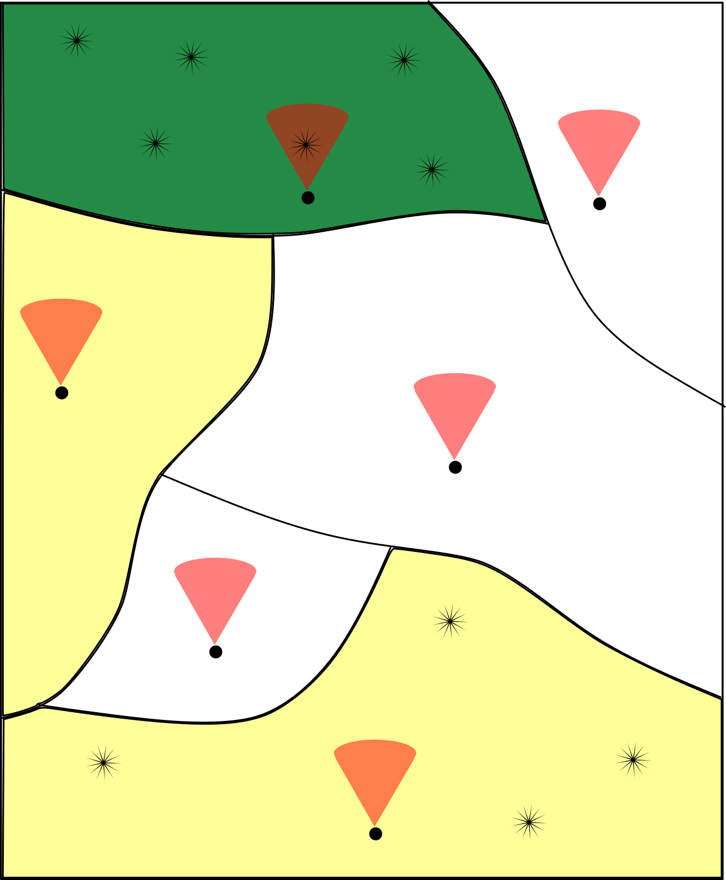
The occurence of ‘0’ in ecological surveys
True zeros
False zeros
Detections (true ones)
Camera trap
Animal

Slide 38
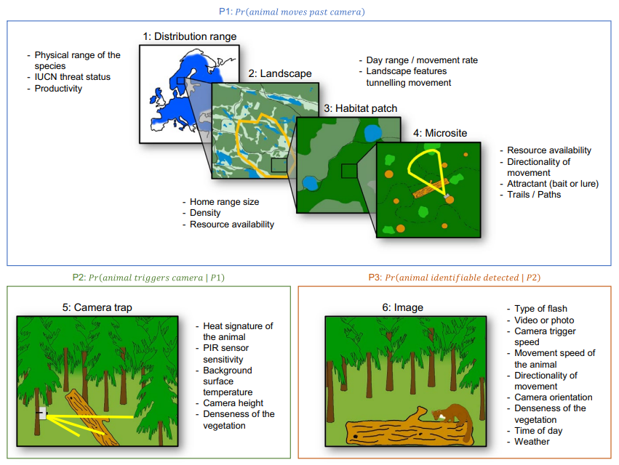
Reasons why a species might not be observed
Hofmeester et al. 2019

Slide 39
Occupancy
“What is the probability that a species is actually present at a location, given its detection history?”
So in essence, we try to correct the proportion of locations where a species is observed by accounting for their detectability
Detectability = the probability that a species is observed, given its presence

Slide 40
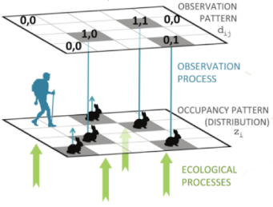
Occupancy
Estimate proportion of area occupied (PAO)* by a target species
Two processes:
Ecological process →
true occupancy/ presence (𝛹)
Observational process →
detection state (P)
Problem:
Detection confirms presence
Non-detection does not confirm absence!
Model detection probability
* Given that the closure assumption is not violated
Guillera‐Arroita. 2017

Slide 41
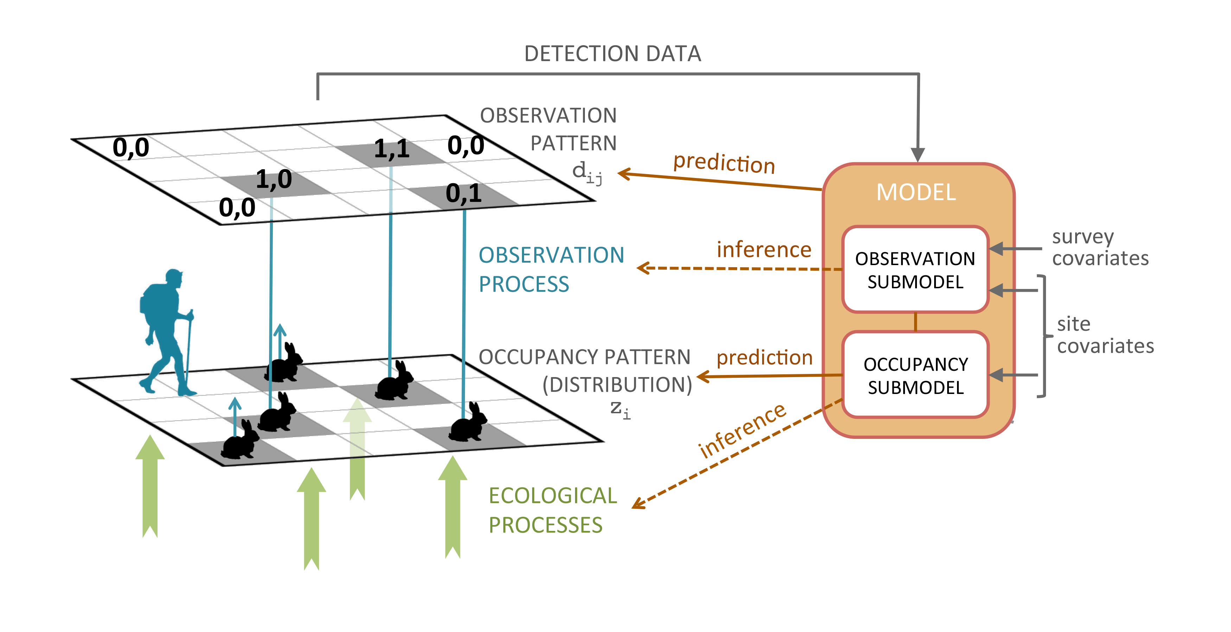
Occupancy

Slide 42

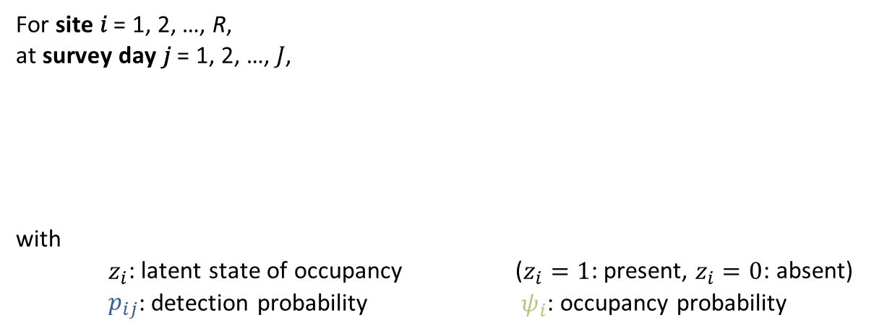
Single-season occupancy model
For site 𝑖 = 1, 2, …, R,
at survey day 𝑗 = 1, 2, …, 𝐽,
with
$z_{i}$: latent state of occupancy ($z_{i}=1$: present, $z_{i}=0$: absent)
$p_{ij}$: detection probability $ψ_{i}$: occupancy probability
$y_{ij}|z_{i}\sim Bernoulli(z_{i} p_{ij})$,
$$z_{i}\sim Bernoulli\left(ψ_{i}\right)$$

Slide 43
Single-season occupancy model - assumptions
Assumption | Logistic regression model | Occupancy model
Detection probability = 1 | ✓
Detections are independent of each other | ✓ | ✓
No fase-positive detections | ✓ | ✓
Geographical closure | ✓ | ✓
No unmodelled heterogeinity | ✓ | ✓

Slide 44
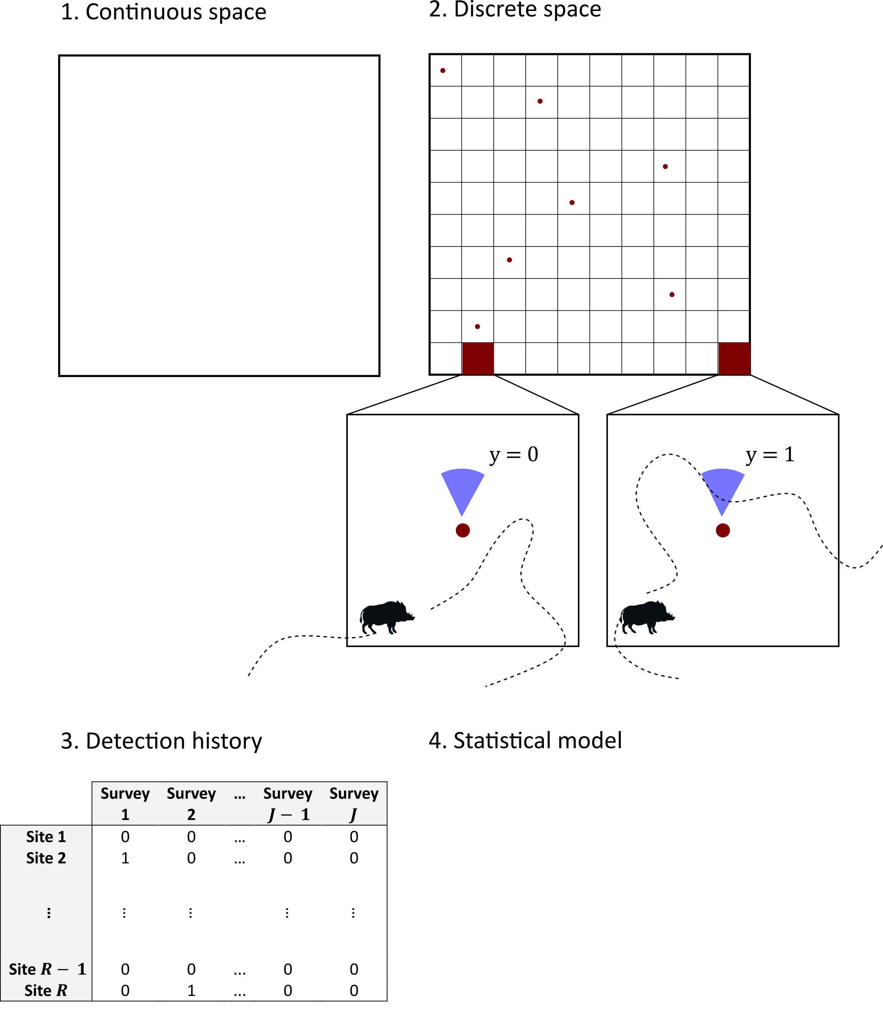
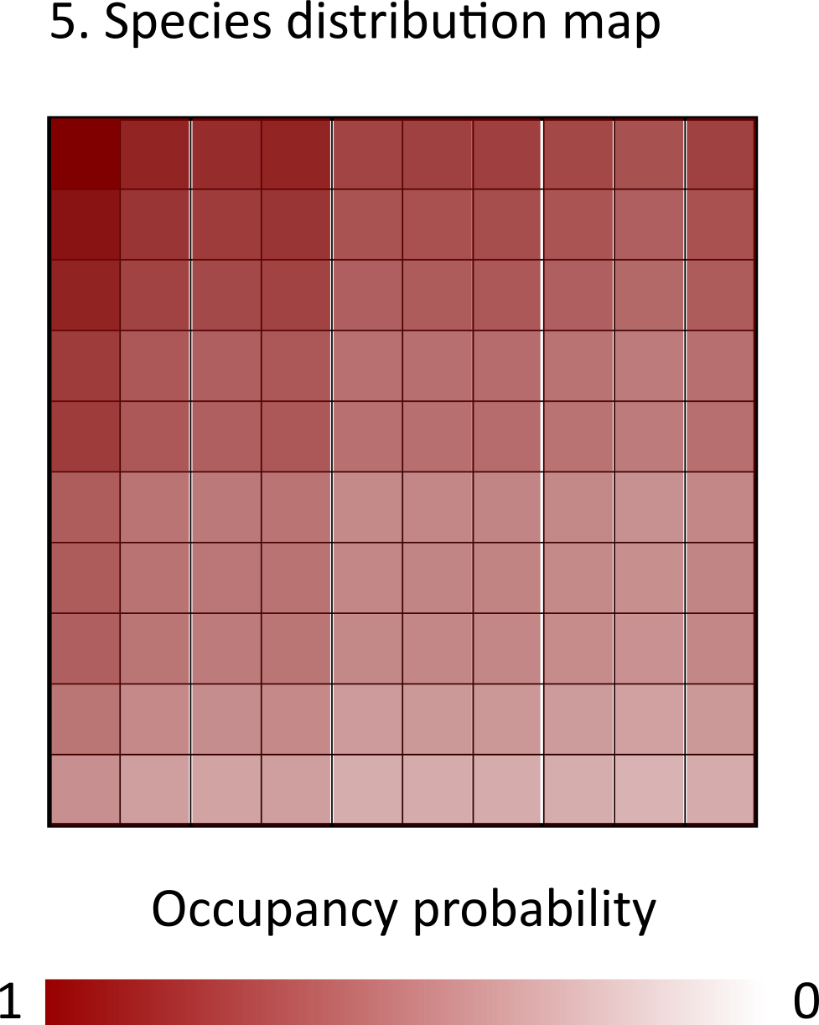
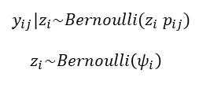
$$y_{ij}|z_{i}\sim Bernoulli(z_{i} p_{ij})$$
$$z_{i}\sim Bernoulli\left(ψ_{i}\right)$$
0
1

Slide 45
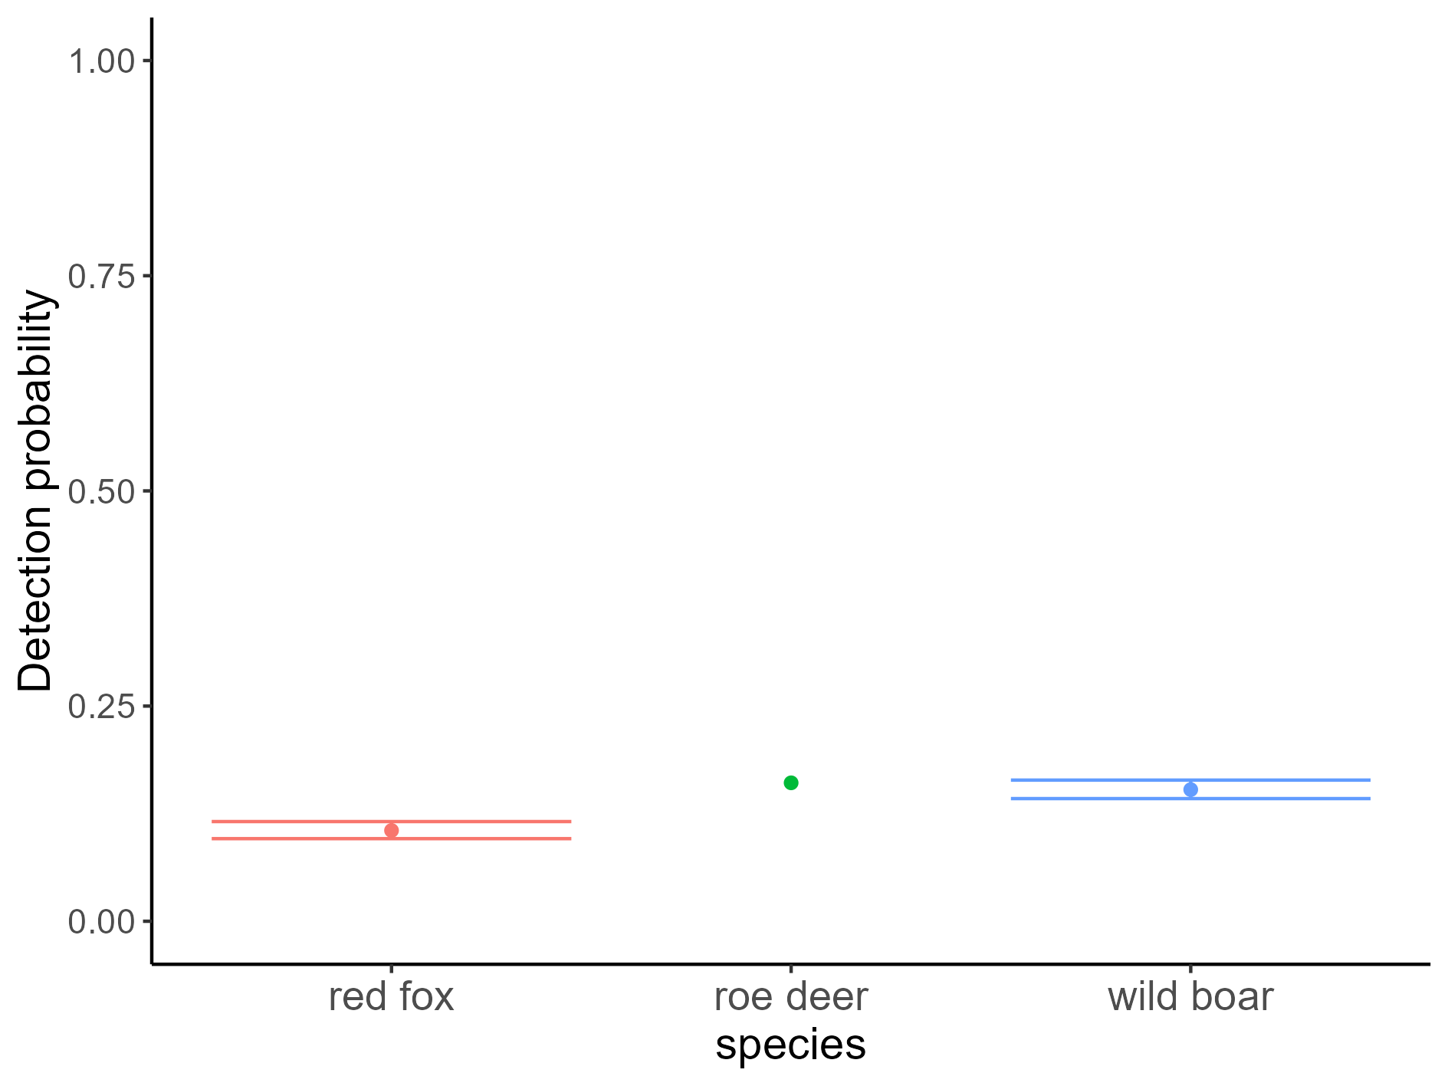
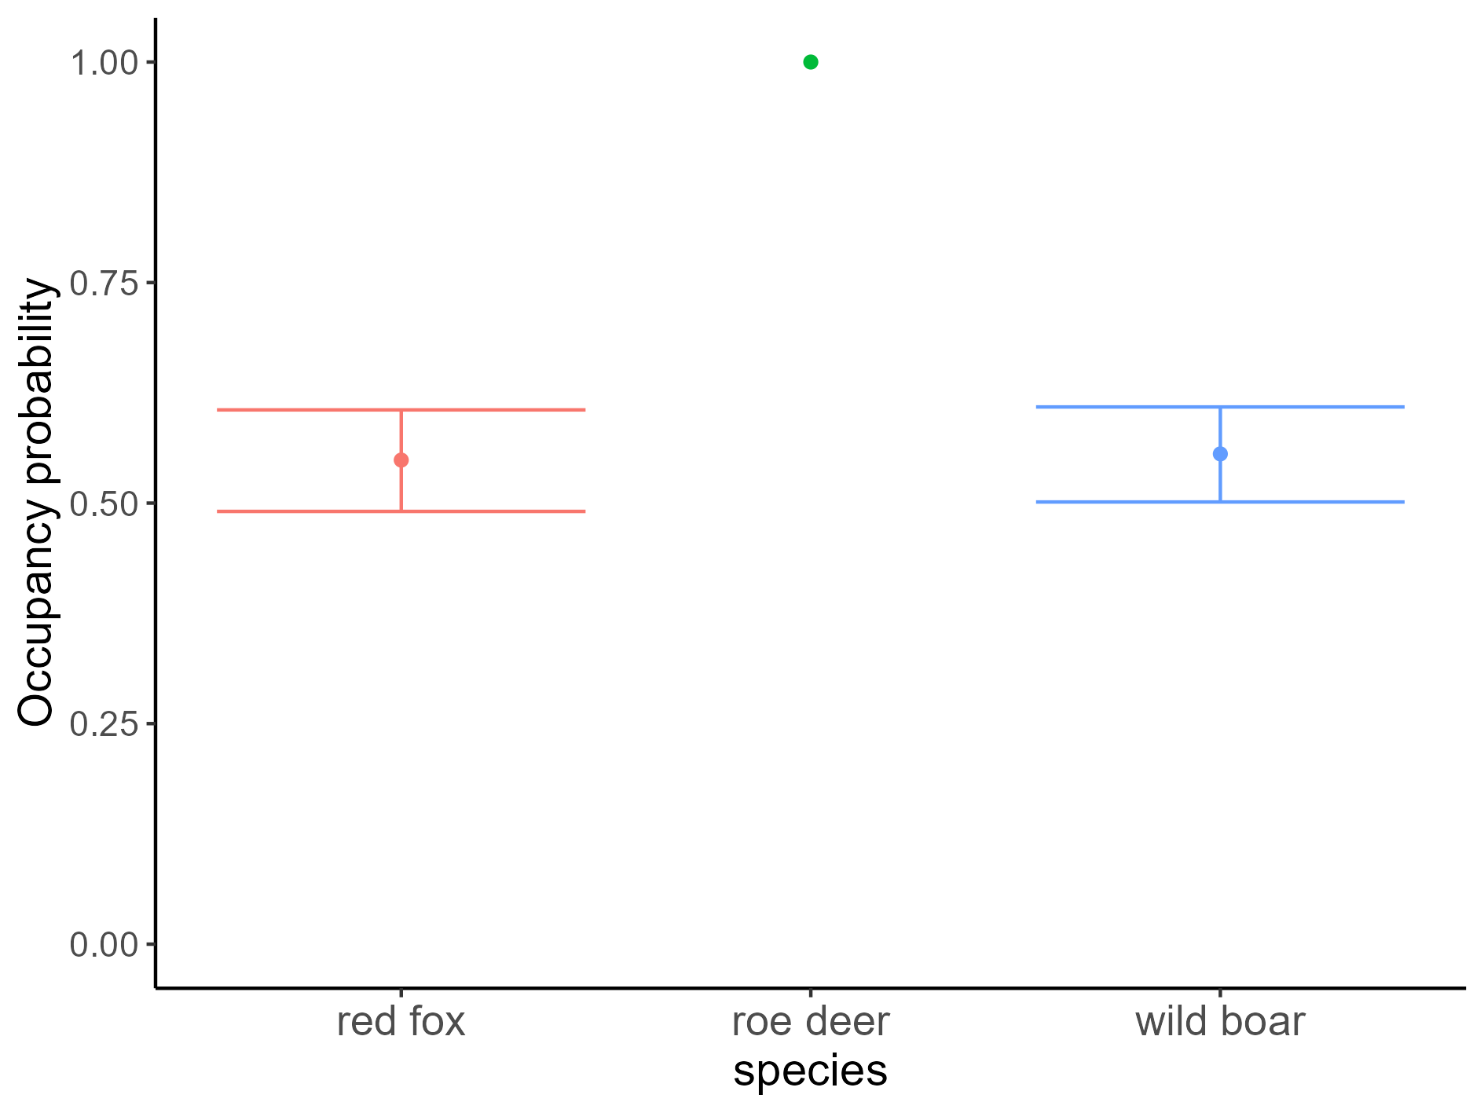
Occupancy

Slide 46
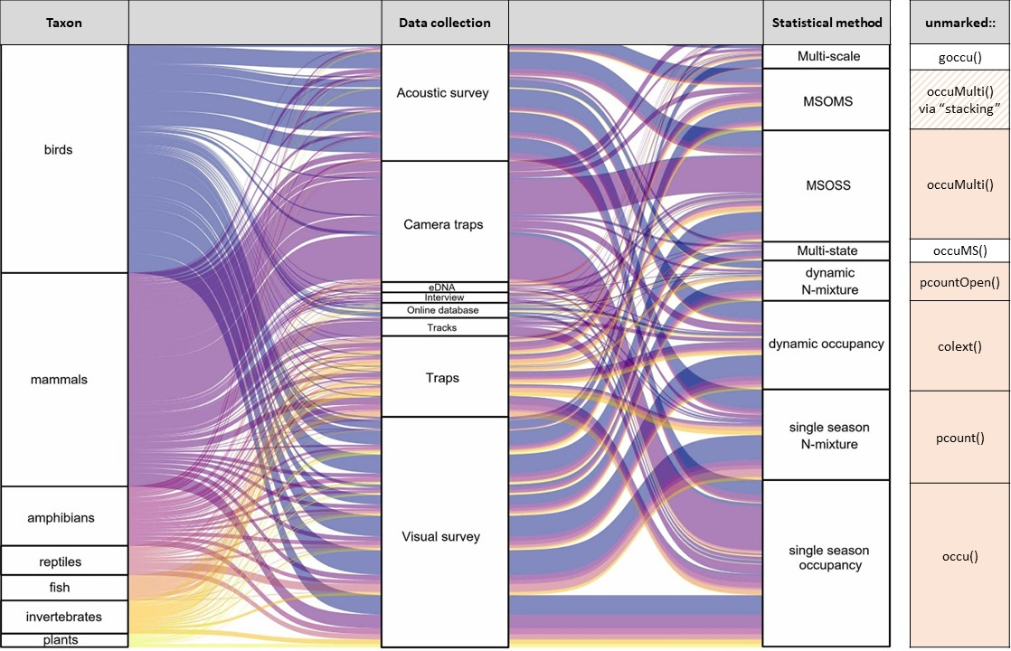
Occupancy
Rozylowicz et al. 2024

Slide 47
Let’s try fitting single-season occupancy models

Slide 48
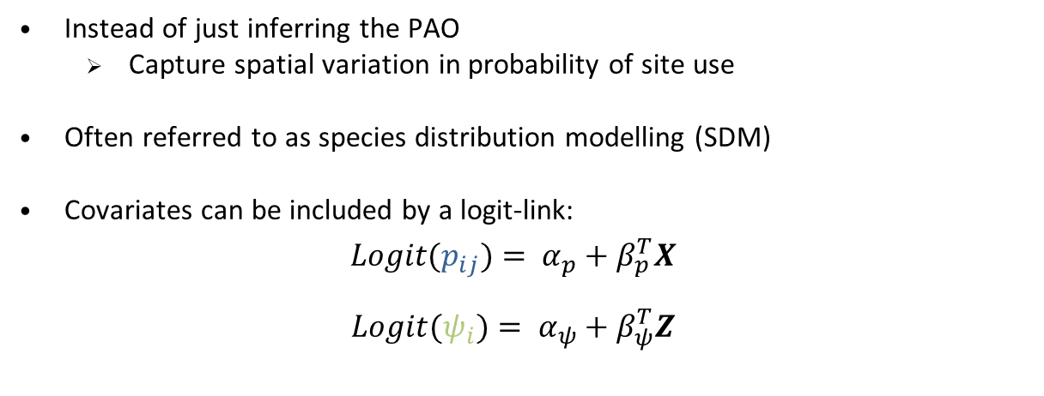
Occupancy – spatial heterogeinity
Instead of just inferring the PAO
Capture spatial variation in probability of site use
Often referred to as species distribution modelling (SDM)
Covariates can be included by a logit-link:
$${Logit(p}_{ij})= α_{p}+β_{p}^{T}X$$
$$Logit(ψ_{i})= α_{ψ}+β_{ψ}^{T}Z$$

Slide 49
$$y_{ij}|z_{i}\sim Bernoulli(z_{i} p_{ij})$$
$$z_{i}\sim Bernoulli\left(ψ_{i}\right)$$
0
1

Slide 50
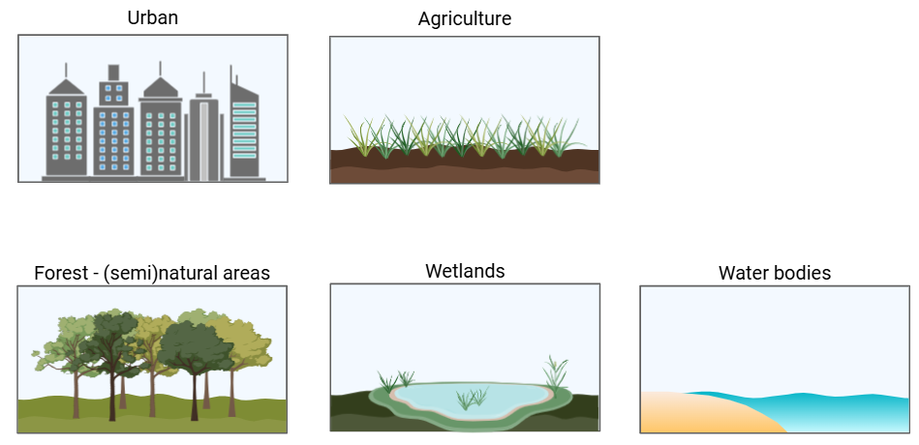
Corine Land Cover - main classes

Slide 51
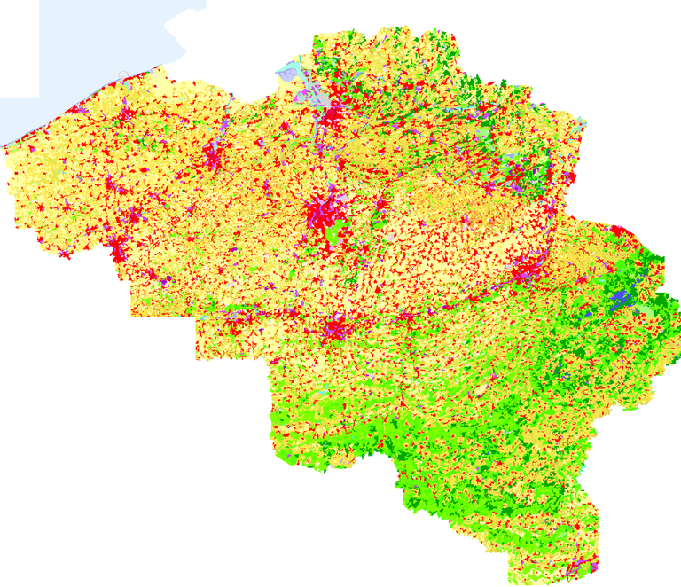
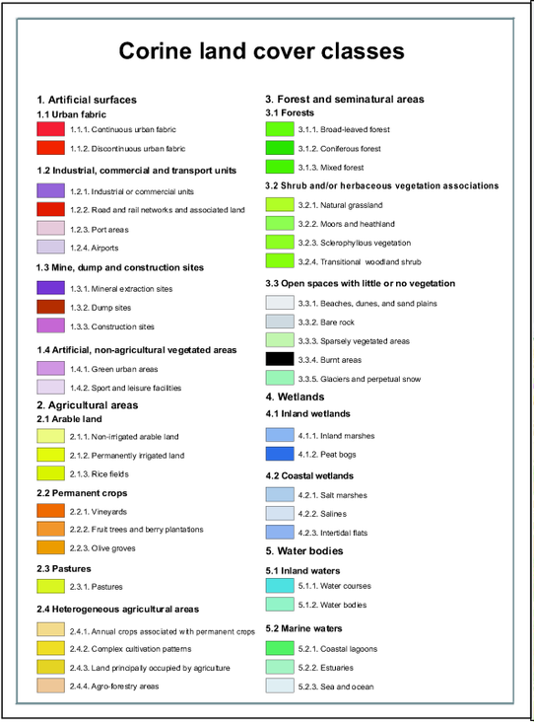
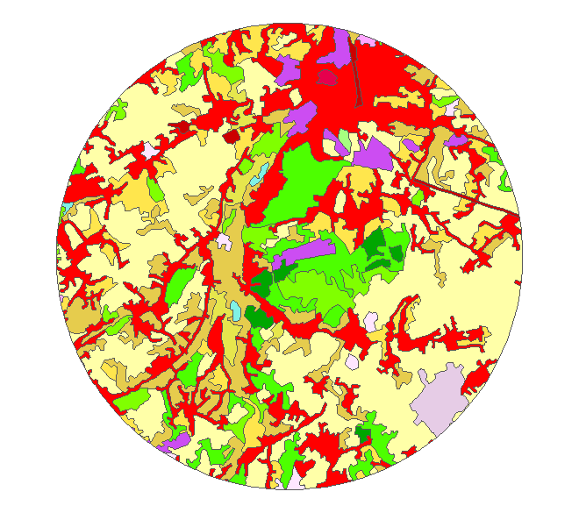

Slide 52
Let’s try fitting single-season occupancy models with covariates

Slide 53
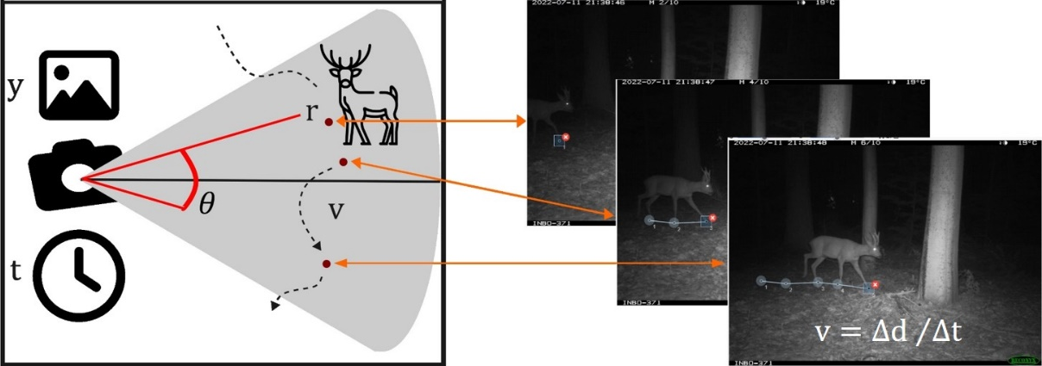
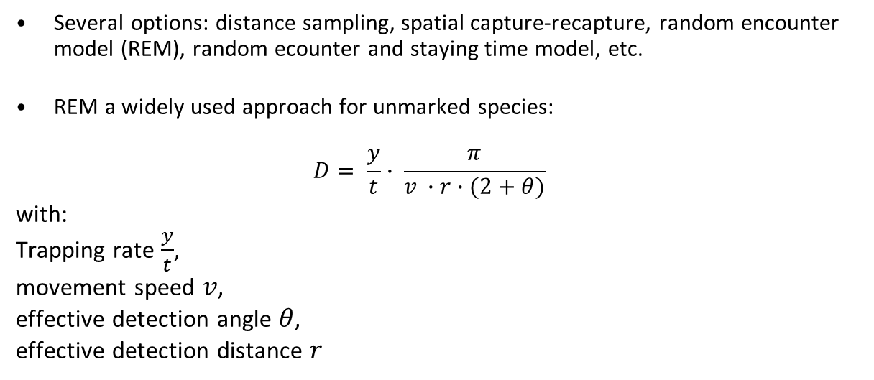
Density-estimation using CTs
Several options: distance sampling, spatial capture-recapture, random encounter model (REM), random ecounter and staying time model, etc.
REM a widely used approach for unmarked species:
$$D= \frac{y}{t}∙ \frac{π}{v ∙r∙(2+θ)}$$
with:
Trapping rate $\frac{y}{t}$,
movement speed $v$,
effective detection angle $θ$,
effective detection distance $r$

Slide 54
REM - assumptions
Assumption | Random Encounter Model
Random CT placement relative to animal movement | ✓
Detections are independent of each other | ✓
Certain detection at 0 distance | ✓
Closed population | ✓

Slide 55
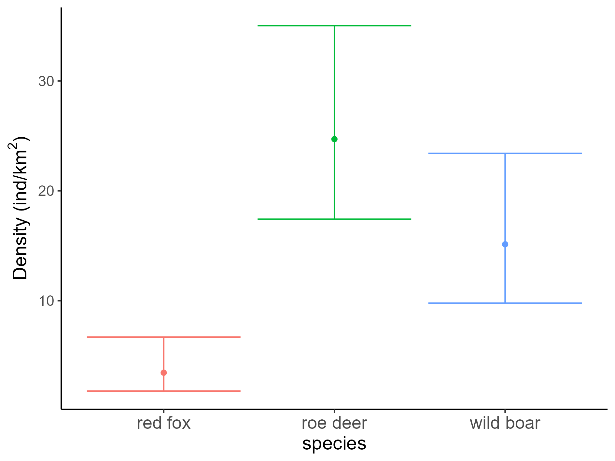
Density

Slide 56
Let’s try fitting the Random Encounter Model

Slide 57
Questions?

Slide 58
References
Bubnicki, J.W., Norton, B., Baskauf, S.J., Bruce, T., Cagnacci, F., Casaer, J., Churski, M., Cromsigt, J.P.G.M., Farra, S.D., Fiderer, C., Forrester, T.D., Hendry, H., Heurich, M., Hofmeester, T.R., Jansen, P.A., Kays, R., Kuijper, D.P.J., Liefting, Y., Linnell, J.D.C., Luskin, M.S., Mann, C., Milotic, T., Newman, P., Niedballa, J., Oldoni, D., Ossi, F., Robertson, T., Rovero, F., Rowcliffe, M., Seidenari, L., Stachowicz, I., Stowell, D., Tobler, M.W., Wieczorek, J., Zimmermann, F. and Desmet, P. (2024). Camtrap DP: an open standard for the FAIR exchange and archiving of camera trap data. Remote Sens Ecol Conserv, 10: 283-295. DOI 10.1002/rse2.374.
Delisle ZJ, Flaherty EA, Nobbe MR, Wzientek CM, and Swihart RK. (2021). Next-Generation Camera Trapping: Systematic Review of Historic Trends Suggests Keys to Expanded Research Applications in Ecology and Conservation. Frontiers in Ecology and Evolution 9. DOI 10.3389/fevo.2021.617996.

Slide 59
References
Dénes FV, Silveira LF, and Beissinger SR. (2015). Estimating abundance of unmarked animal populations: accounting for imperfect detection and other sources of zero inflation. Methods in Ecology and Evolution 6:543-556. DOI 10.1111/2041-210x.12333.
Guillera‐Arroita, G. (2017). Modelling of species distributions, range dynamics and communities under imperfect detection: advances, challenges and opportunities. Ecography, 40(2), 281-295. DOI 10.1111/ecog.02445.
Hofmeester TR, Cromsigt JPGM, Odden J, Andrén H, Kindberg J, Linnell JDC. (2019). Framing pictures: A conceptual framework to identify and correct for biases in detection probability of camera traps enabling multi-species comparison. Ecol Evol. 9: 2320–2336. DOI 10.1002/ece3.4878.

Slide 60
References
Rozylowicz L, Popescu VD, Manolache S, Nita A, Gradinaru SR, Mirea MD, and Bancila RI. (2024). Occupancy and N-mixture modeling applications in ecology: A bibliometric analysis. Global Ecology and Conservation 50:e02838. DOI 10.1016/j.gecco.2024.e02838.
Wearn, Oliver & Glover-Kapfer, Paul. (2017). Camera-trapping for conservation: a guide to best-practices. 10.13140/RG.2.2.23409.17767.

Slide 61
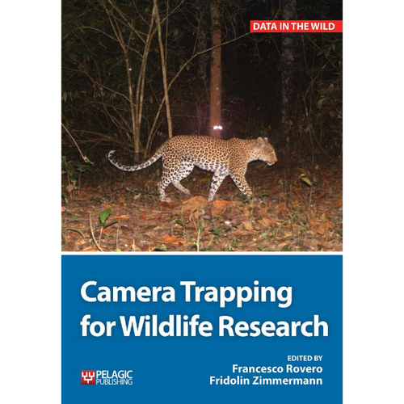
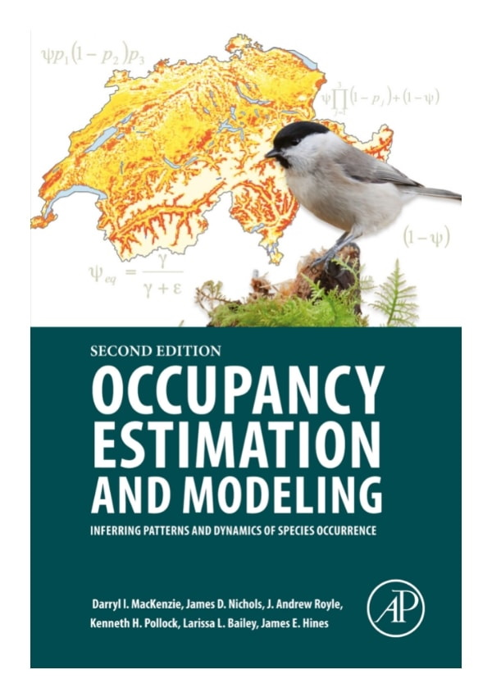
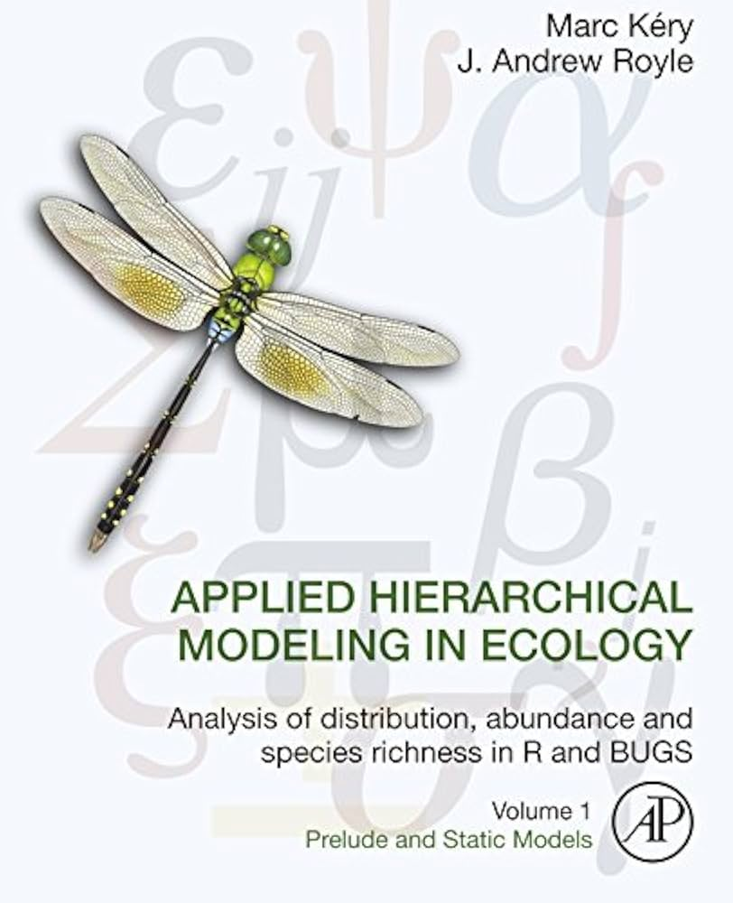
Suggested reading

